Slide 1
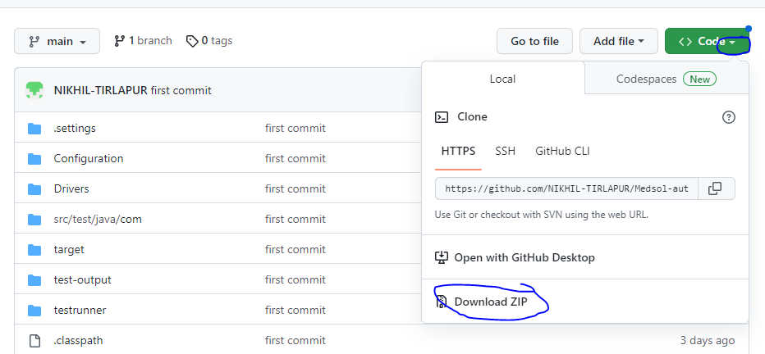
HOW TO SET UP FRAMEWORK
Step 1:-create maven project in the eclipse ide.
Step 2:- download the framework from the github using below link
https://github.com/NIKHIL-TIRLAPUR/Medsol-automation.git
Click on the code dropdown and download zipfile

Slide 2
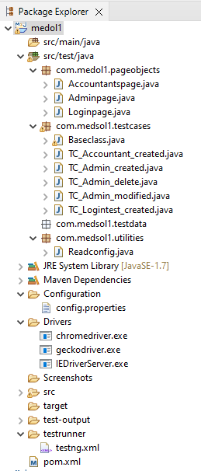
Step 3:- create project structure .

Slide 3
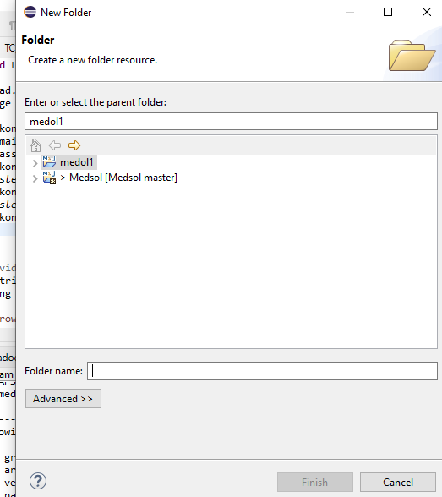
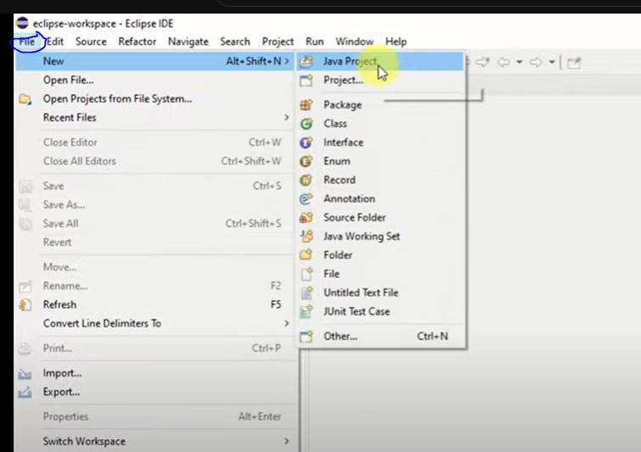
Step 4:- to create folder in project
Right click on the project ->new ->folder click on it , enter the name of the folder and click on finish

Slide 4
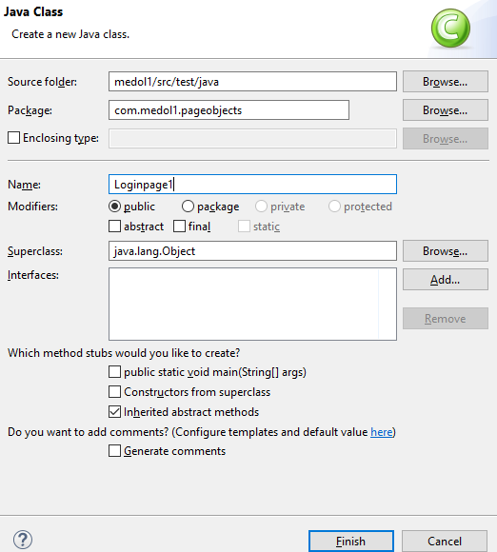
Step 5:- these are the folders to be crated in the project by following step 4.
Drivers
Screenshot
Test runner
To create class in the package right click on the package->new -> class->click on it ,Provide name and click on finish.

Slide 5
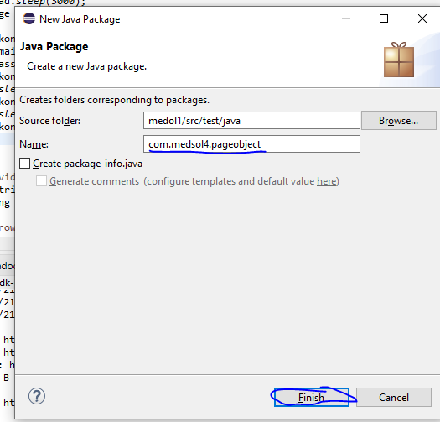
Step 6:- create package in the src/test/java
Right Click on the src/test/java –> new->package
Enter the package name and click finish

Slide 6
Create following packages
com.medsol4.pageobject
com.medsol4.testcases
com.medsol4.testdata
com.medsol4.utilities
Step 7:- create class in the pageobjects package
And copy the code form the downloaded zip file
Paste it in the crated class.
Step 8:- create class in the testcase package and copy the code from the downloaded zip file paste it in the crated test class.
Step 9:- copy the driver file from the downloaded zip file and paste them in the created driver folder of the project

Slide 7
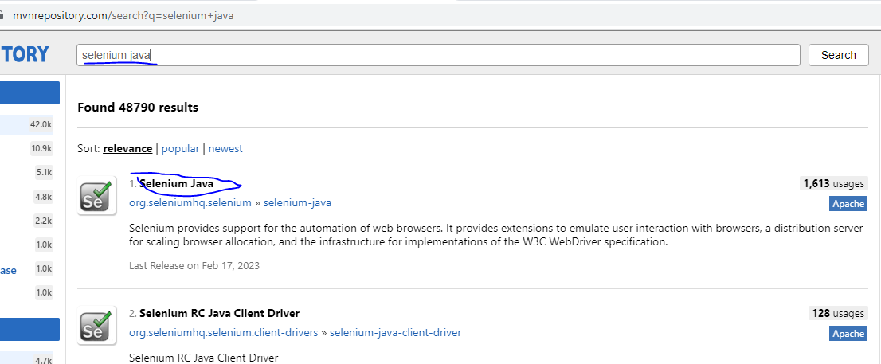
Step 10:- copy the baseclass from the downloaded zip file and paste it in the testcase package by crating the same class in the testcase Package
Step 11:- update the pom.xml file by adding dependencies in it .
Go to maven repository and search for the required dependencies and copy paste the dependency.

Slide 8
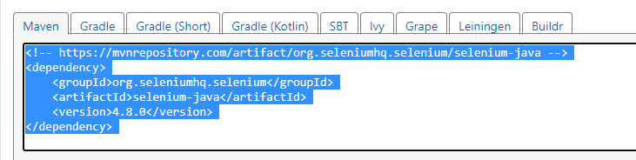
Step 12:-copy the Readconfig.java file from the downloaded zip and paste it in the utilities package.
Step 13:-copy the config.properties file from the downloaded zip and create file as config.properties paste it in the configuration folder.

